Slide 1
BUSINESS ETHICS
LESSON 1 – INTRODUCTION - CORPORATE SOCIAL RESPONSIBILITY and WHISTLEBLOWING

Slide 2
CHECKLIST
Explain the idea of corporate social responsibility.
Explain with examples the idea of whistle-blowing
Explain what is meant by globalisation and how this is linked to this topic
Explain and assess how well the theory of utilitarianism addresses the issues in business ethics
Explain and assess how well the theory of Kantian Ethics addresses the issues in business ethics
Assess whether corporate social responsibility is genuine or whether businesses are merely going through the ethical motions
Assess whether globalisation encourages or discourages business being ethical
Consider whether humans can flourish in our capitalist consumerist society.

Slide 3
SOME DISCUSSIONS
The same T-shirt that was £10 in Topshop is £4 in primark and £5 in Tesco. A similar T-shirt with a designer label in ‘Clothing La-Posh’ is £20. What would you buy?
The burgers in Sainsco say 100% beef. Does it matter if they are not?
Organic free range eggs cost over £1 for half a dozen. There are other own brand eggs in the shop for less than 50p. How come? Which to buy?
HARDER: In the UK we have minimum wage and are also obliged to pay people equally regardless of gender. It is a lot cheaper to produce goods in countries without these laws. (Term - Globalisation)
HARDER: Bankers and shareholders receive large bonuses when the business does well. Should some of the profits also be passed on to the customers? (Terms - shareholders vs stakeholders)

Slide 4
Key Concept
Corporate Social Responsibility - the idea that businesses and organisations have ethical responsibilities to the wider community and the environment (all stakeholders)
The diagram on the next page (see also p45 of revision guide) shows how it may be possible to get a sense of how ethical a business is

Slide 5
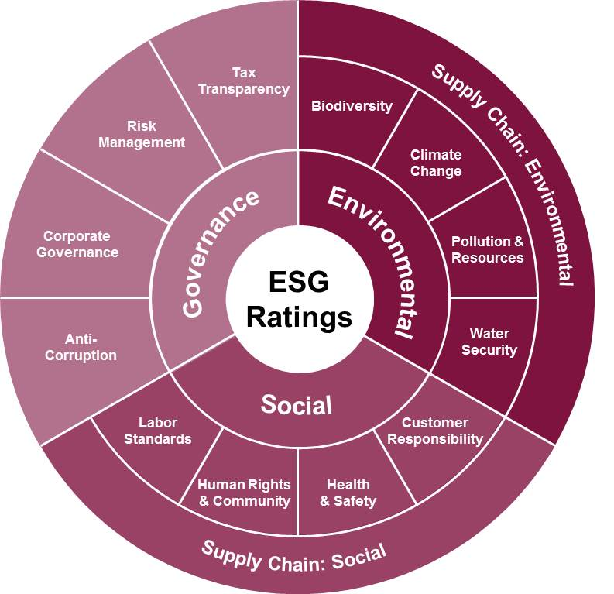

Slide 6
CSR: What’s not to like?
It would seem that corporate social responsibility is a good idea and that all businesses should behave ethically - however the real world is not like that. What happens if doing the right thing starts to cost you money?

Slide 7
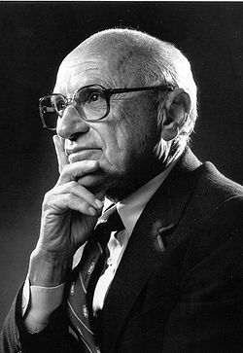
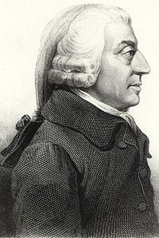
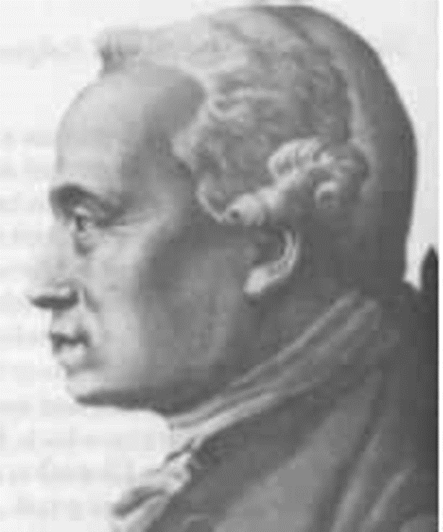
3 VIEWS
Friedman – Businesses exist to make money - no need for CSR
Smith – Good Ethics IS Good Business. CSR helps the business in the end. (Utilitarian)
Kant – Good Ethics is more important than Good Business. Do the right thing even if you lose money.

Slide 8
MEET MILTON FRIEDMAN
"there is one and only one social responsibility of business–to use its resources and engage in activities designed to increase its profits so long as it stays within the rules of the game, which is to say, engages in open and free competition without deception or fraud."
Friedman argues that there is no business ethics as such
‘What does it mean to say that "business" has responsibilities? Only people can have responsibilities. A corporation is an artificial person and in this sense may have artificial responsibilities, but "business" as a whole cannot be said to have responsibilities, even in this vague sense.’
Friedman’s views have been very influential in the late 20th and early 21st century: In the 1980s - President Reagan and Prime Minister Margaret Thatcher. Modern Right Wing Politics too...

Slide 9
Task 1 : CSR and Friedman
What is corporate social responsibility?
What sort of things might it involve?
What does Milton Friedman think about corporate social responsibility?
Why does he think this?
Extension: Look at your copy of the ESG rating diagram. What examples might there be of ethical/unethical behaviour? If it helps - think of a business you are aware of - Is your business ethical as far as you are aware? Why or why not?

Slide 10
Whistleblowing:
What should Sanjeev do?
Sanjeev felt sure he stood a good chance of getting the job of Deputy Head. He had far more experience than Alison and he knew that her application had gone in two days late. He was disappointed to learn that she had got the job and suspected the fact that she was the Head’s partner may have been significant. He wants to tackle the issue but a friend reminds him how the head of science ‘disappeared’ last year after a row with the Head. What ethical issues are there here? What should Sanjeev do?

Slide 11
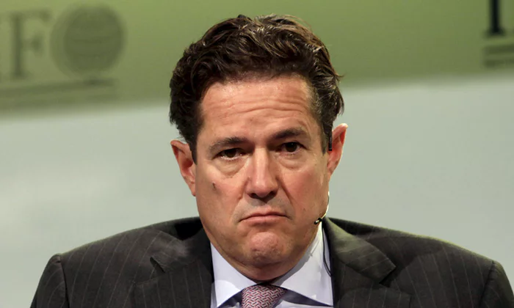
WHISTLEBLOWING - recent case
Barclays boss Jes Staley has been reprimanded and has lost £1 million of his bonus after using the bank’s security team to try to find the identity of a whistleblower who had objected to one of Staley’s friends being appointed to the board

Slide 12
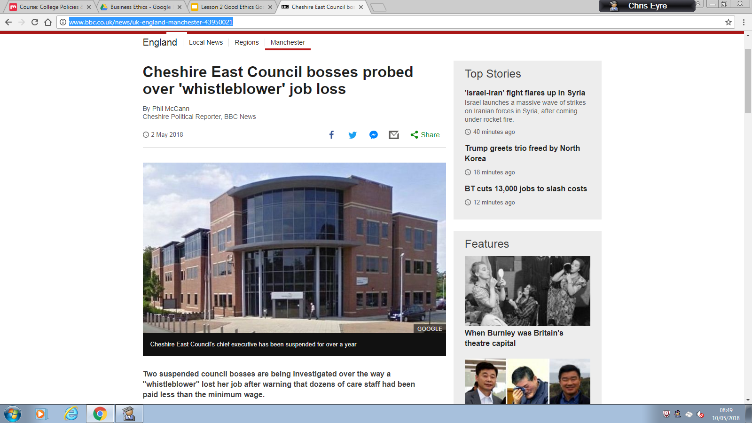
May 2018
http://www.bbc.co.uk/news/uk-england-manchester-43950021

Slide 13
TASK 2:
WHISTLEBLOWING QUESTIONS
Read the notes on Whistleblowing
What is Whistleblowing? Why might someone become a whistleblower?
What is the difference between private and public whistleblowing?
How might whistleblowing link to the idea of corporate social responsibility?
Is there some situations where your duty to your company is more important than other ethical concerns? Are there some situations where ethical concerns matter more (2-3 sentences with examples)
Is whistleblowing a good thing overall? (why/why not?)

